Slide 1
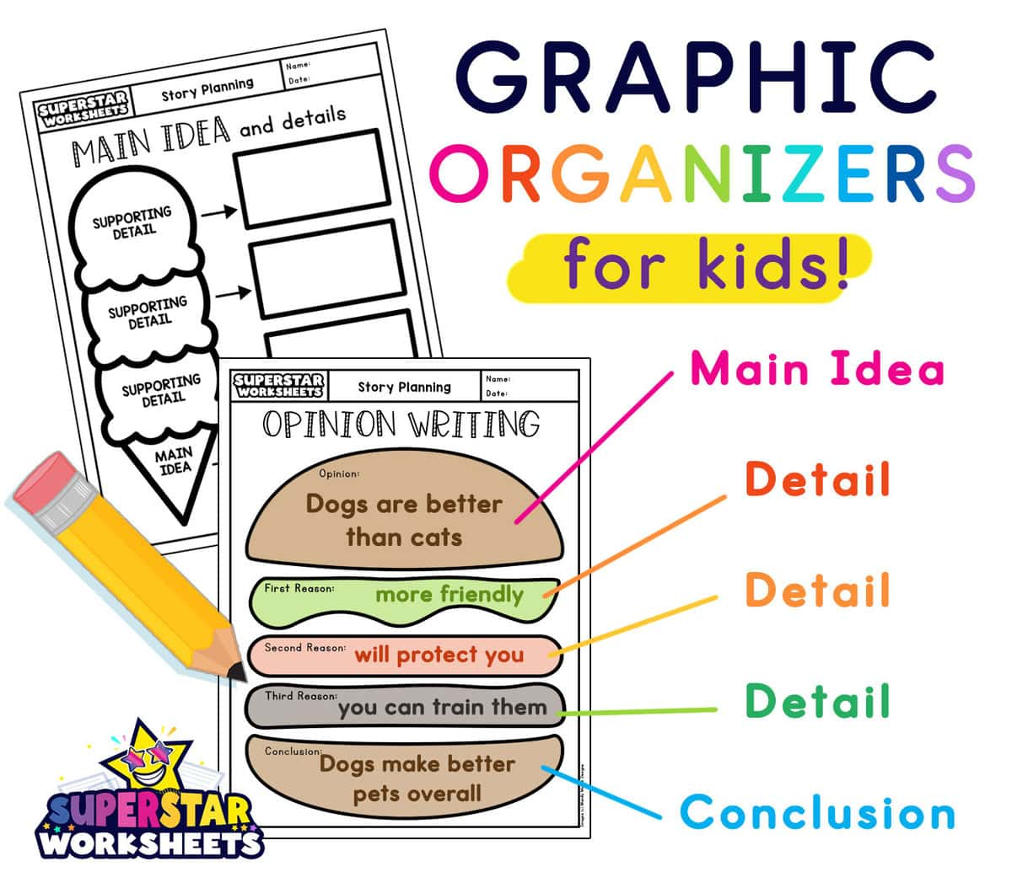
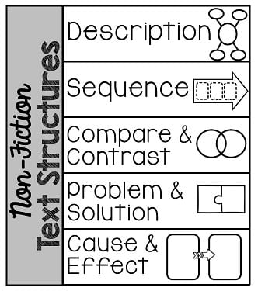
It is a visual tool that helps you organize and structure information. They can help you compare and contrast ideas, brainstorm, and plan what to write.

Slide 2
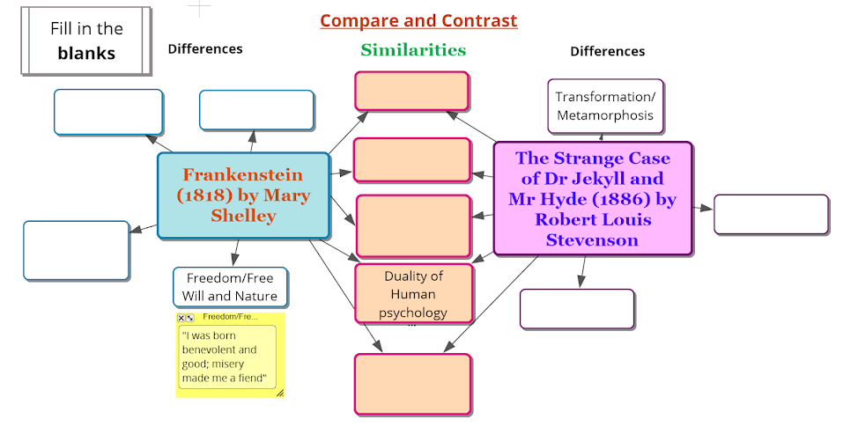
https://www.youtube.com/watch?v=rEnf_CFoyv0

Slide 4
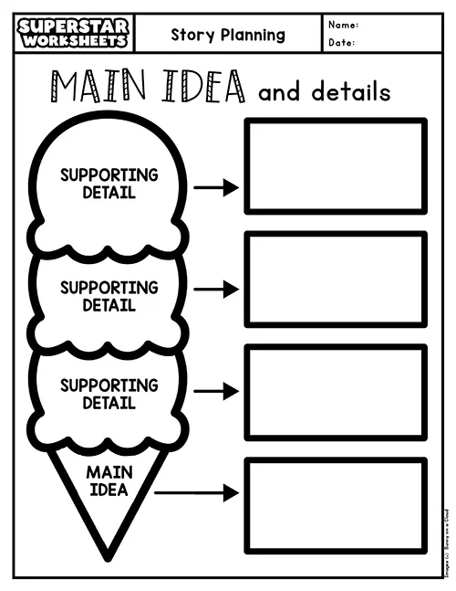

Slide 5
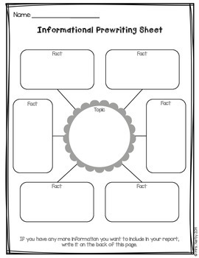

Slide 6
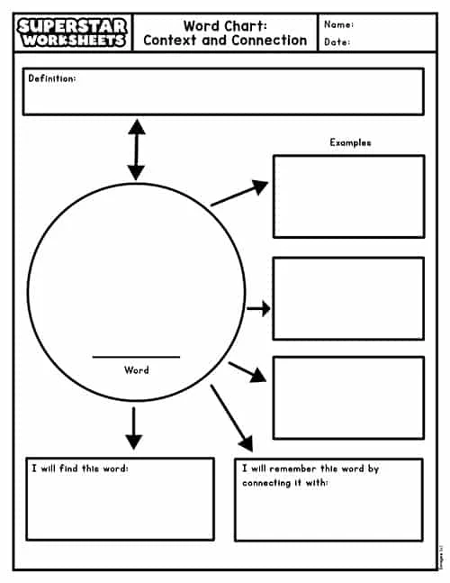

Slide 7
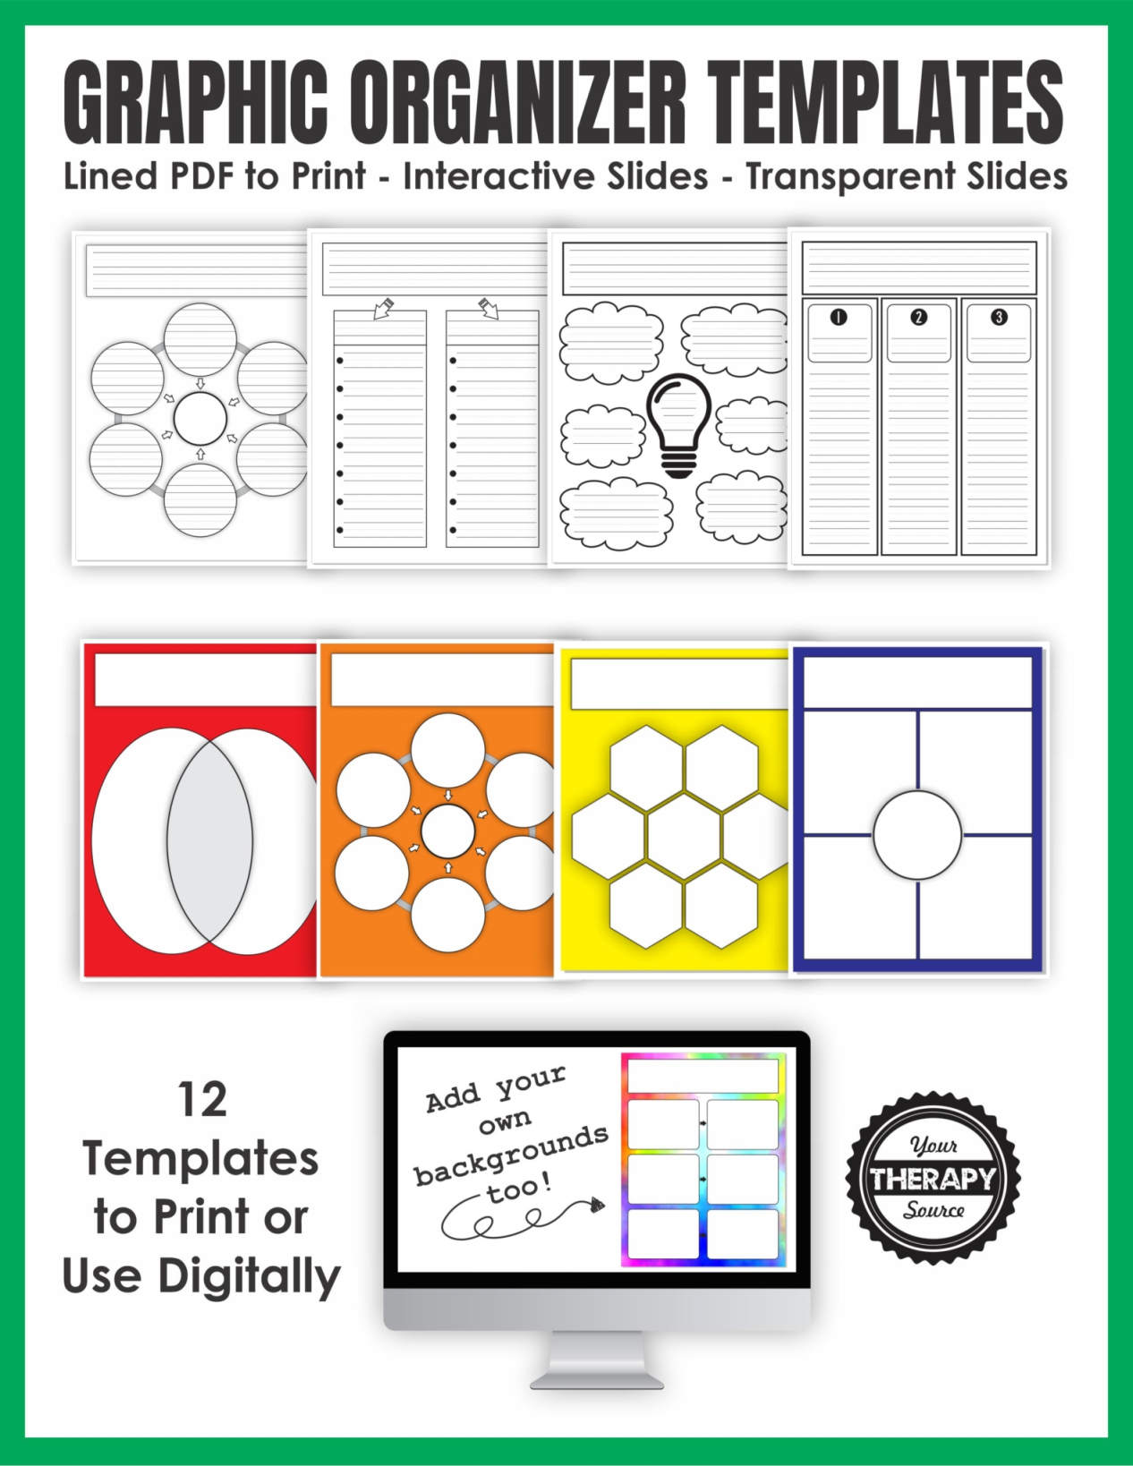

Slide 8
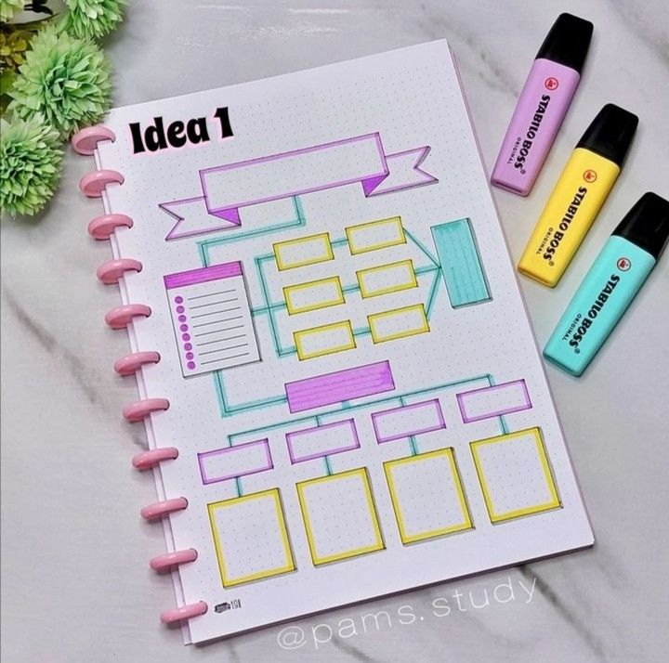

Slide 9
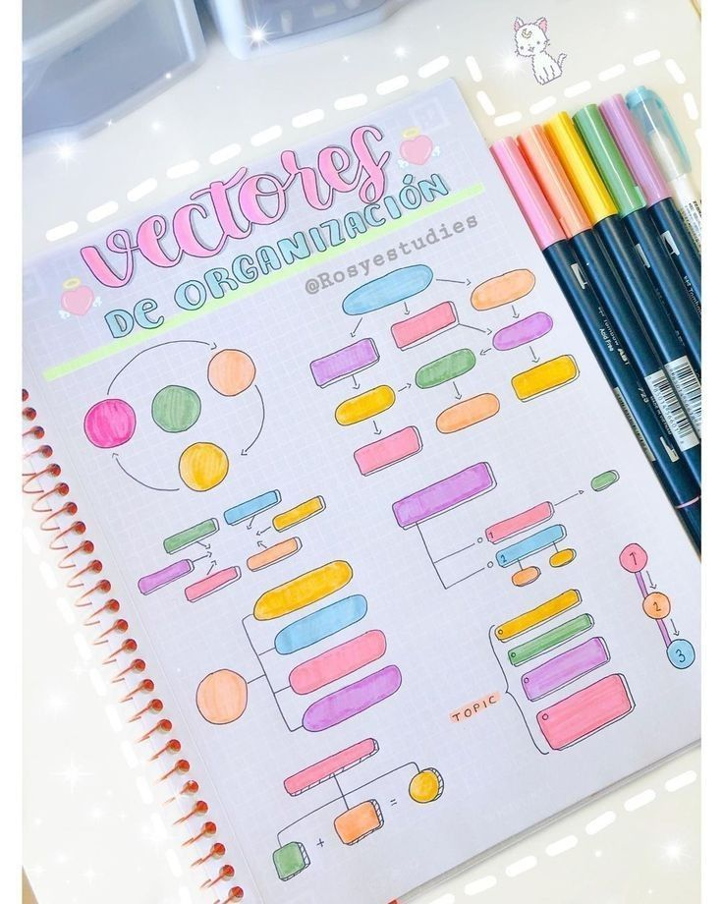

Slide 10
INEQUALITIES VIDEO
https://www.youtube.com/watch?v=rEnf_CFoyv0

